Slide 1
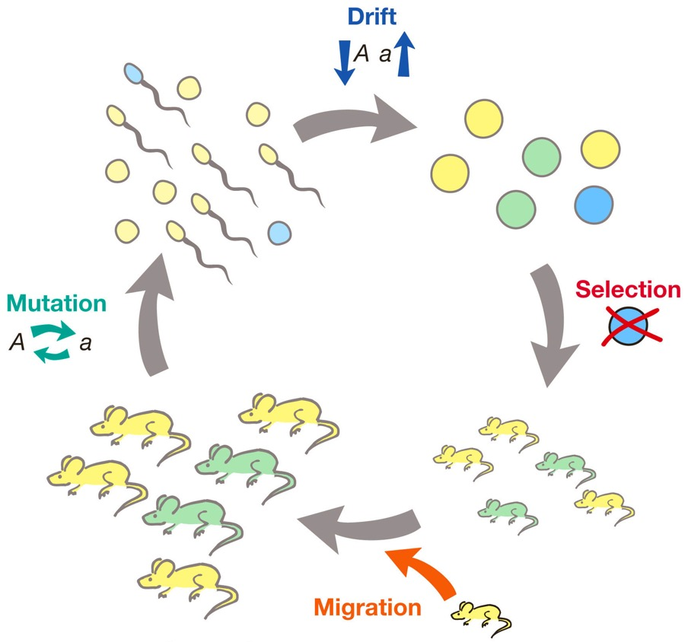
Selection and other evolutionary forces
Selection does not always drive alleles to fixation
Selection can maintain allele frequencies at an intermediate equilibrium
Selection can cause the fixation of alleles that confer lower fitness
Effects of fluctuating selection
Interactions between selection and mutation
Interactions between selection and genetic drift
Interactions between selection and migration

Slide 2
Discussion questions
In relation to the R exercise
How does the strength of selection and mutation rate impact the frequency of a deleterious allele?
How does drift impact allele frequencies over time?
Is drift or selection more important in shaping allele frequencies?
What happens to populations when divergent selection and migration are happening at the same time?
Why do you think mathematical models are useful? Fundamentally, what insights can we gain from “playing with math”?
Now that you have learned about and modeled the effects of the different evolutionary forces, how would you rank the different forces in terms of their importance for the evolution of biodiversity?
Before you get started:
Make sure to introduce each other
Choose a timekeeper
Choose a reporter
Breakout groups for 20 minutes

Slide 3
Mutation-selection balance
High mutation rate
Most mutations are deleterious, and selection acts to eliminate deleterious alleles.
Deleterious alleles persist because of continuous mutation
When rate of elimination is equal to the rate of mutation, the frequency of an allele is at an equilibrium (the mutation-selection balance)
The higher the mutation rate, the higher the frequency of the deleterious allele
Low mutation rate

Slide 4
Mutation-selection balance
Weak selection
Most mutations are deleterious, and selection acts to eliminate deleterious alleles.
Deleterious alleles persist because of continuous mutation
When rate of elimination is equal to the rate of mutation, the frequency of an allele is at an equilibrium (the mutation-selection balance)
The higher the mutation rate, the higher the frequency of the deleterious allele
The higher the strength of selection, the lower the frequency of the deleterious allele
Strong selection

Slide 5
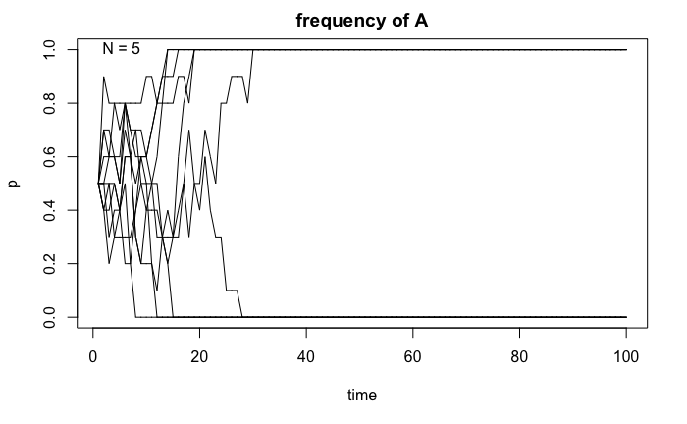
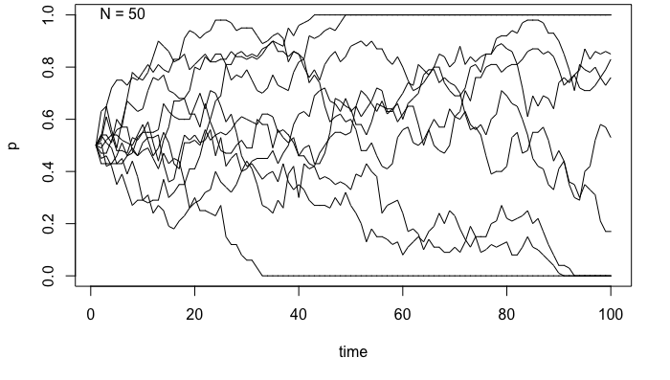
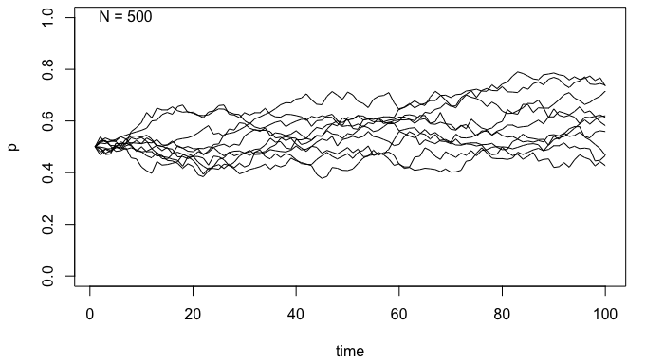
Genetic drift
Genetic drift is most important in small populations, as effects are more dramatic and rapid
Due to the randomness, every population follows a unique evolutionary path
Given enough time, drift can cause substantial changes in allele frequencies, even in large populations
In absence of other evolutionary forces, drift causes the fixation of alleles
As alleles drift to fixation, heterozygotes in the population decline

Slide 6
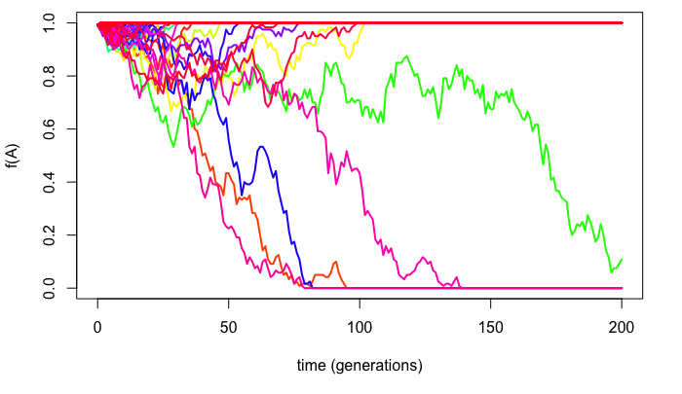
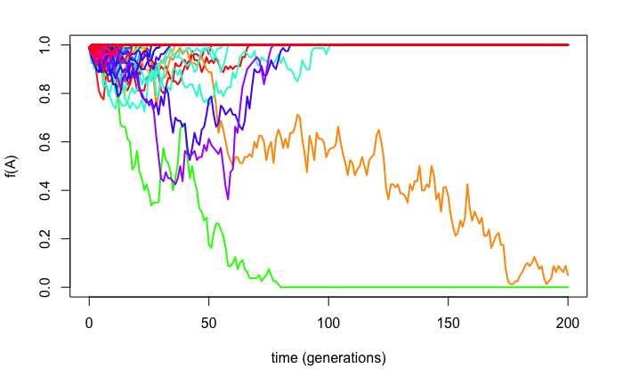
Genetic drift & selection
In small populations, genetic drift can outweigh selection
N=60
Selection for a beneficial mutation
N=60
Selection against a deleterious mutation

Slide 7
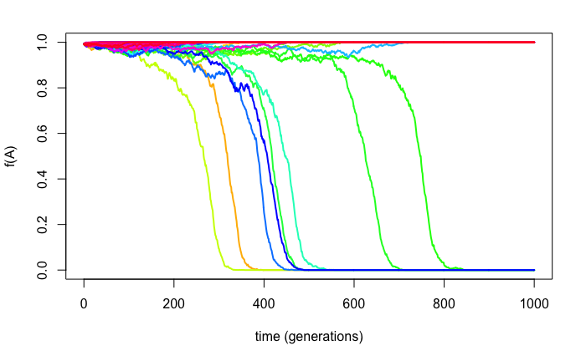
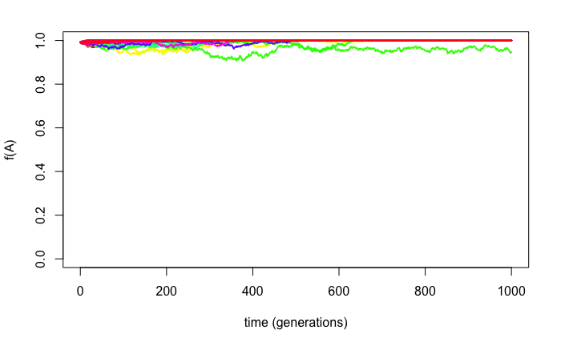
Genetic drift & selection
In small populations, genetic drift can outweigh selection
In large populations, selection is more effective
N=6000
Selection for a beneficial mutation
N=6000
Selection against a deleterious mutation

Slide 8
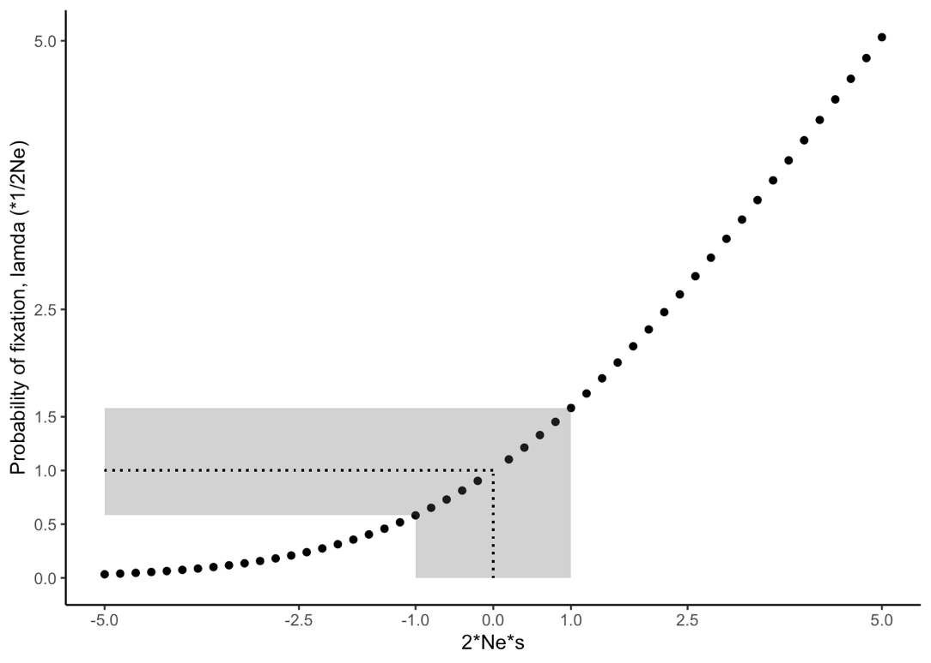
Genetic drift & selection
In small populations, genetic drift can outweigh selection
In large populations, selection is more effective

Slide 9
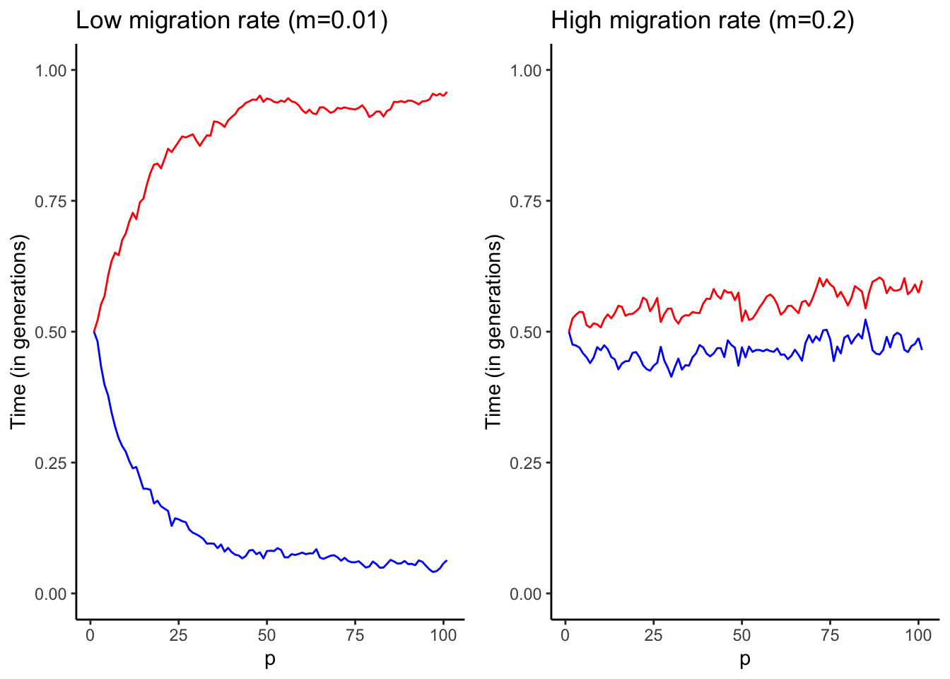
Migration & selection
Divergent selection (and genetic drift) causes populations to differentiate
Migration (gene flow) homogenizes populations
The relative strengths of divergent forces and gene flow determine the fate of the populations

Slide 10
Complex evolutionary dynamics
Interactions among different evolutionary forces can cause complex dynamics
Much of the field tries to disentangle the effects of different forces to explain natural phenomena

Slide 11
Information hidden in DNA

Slide 12
Coronavirus
Origins and molecular evolution
Where did SARS-CoV-2 come from?
What is the SARS-CoV-2 molecular clock and what can we learn from it?
Is there evidence for positive selection on different genes in the SARS-CoV-2 genome?
Epidemiology
Spread and disease dynamics
Manipulating virus fitness and evolution

